Slide 1
Machine Learning – Course Overview
http://fenyolab.org/ml2018

Slide 2

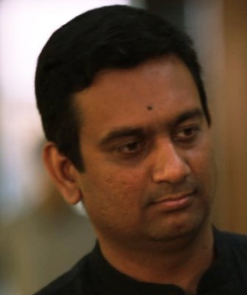
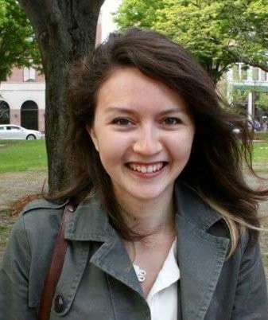
Course Overview
2
Course Directors
Teaching Assistant
Dr. David Fenyo
David@FenyoLab.org
Dr. Kasthuri Kannan
Kasthuri.Kannan@nyulangone.org
Anna Yeaton
Anna.Yeaton@nyulangone.org

Slide 3
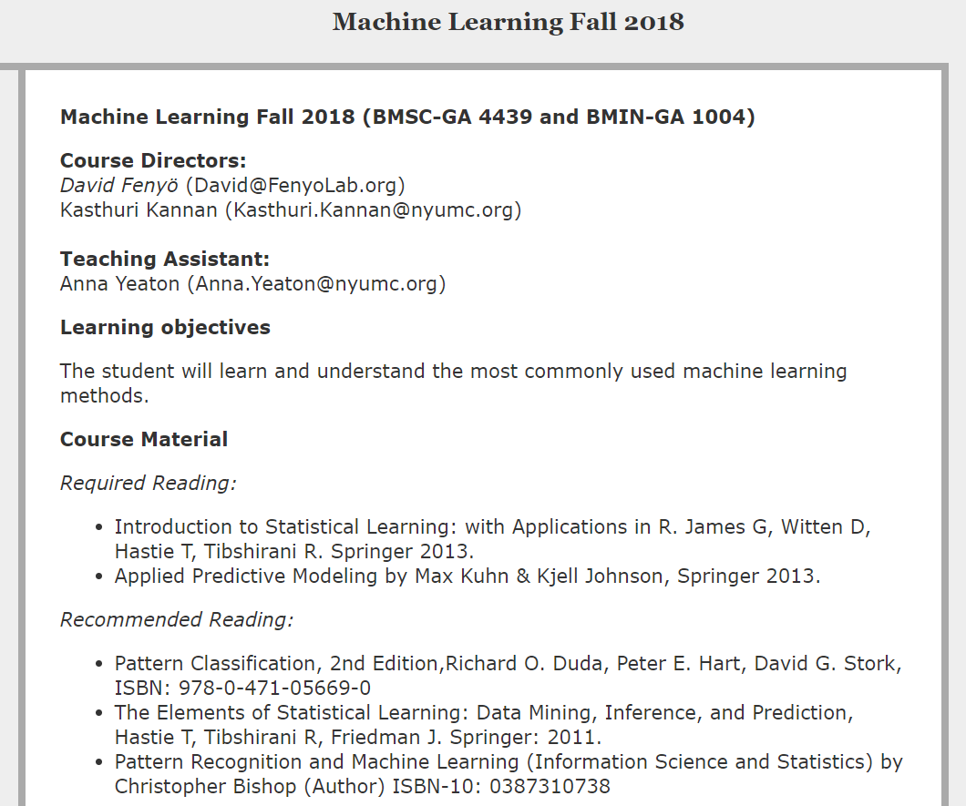
Course Overview
3
http://fenyolab.org/ml2018fall

Slide 4
Course Overview
4
What is machine learning?

Slide 5
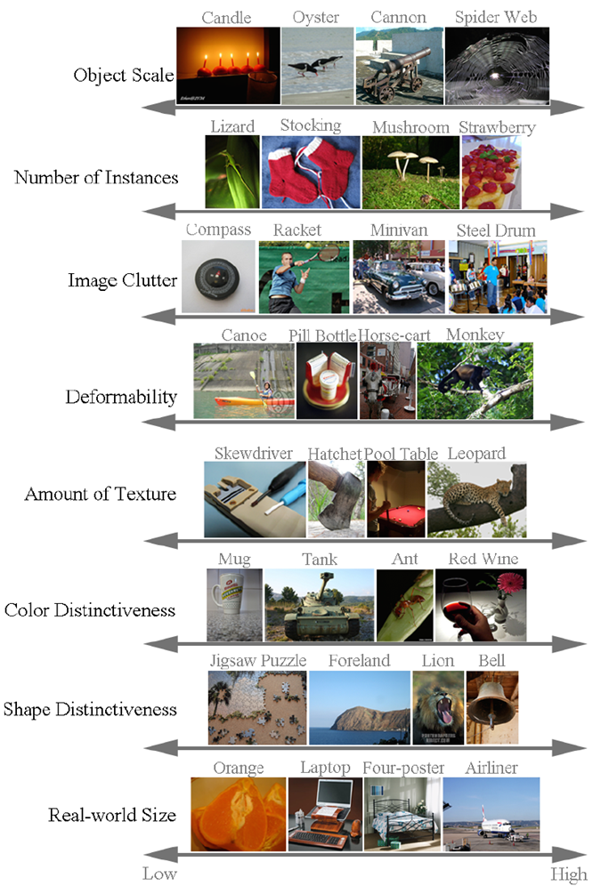
Example: Image Classification
5
Russakovsky et al., ImageNet Large Scale Visual Recognition Challenge. IJCV, 2015.

Slide 6
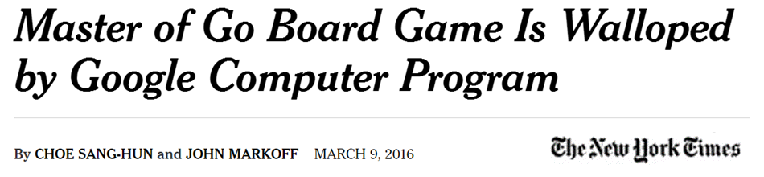
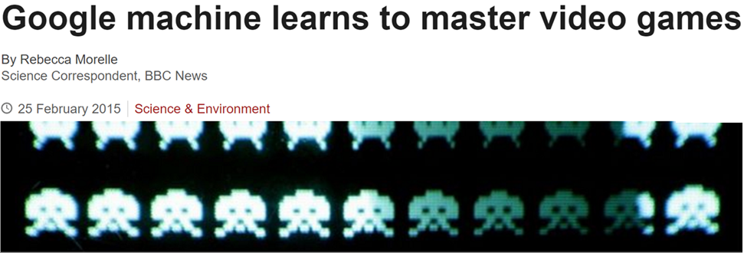
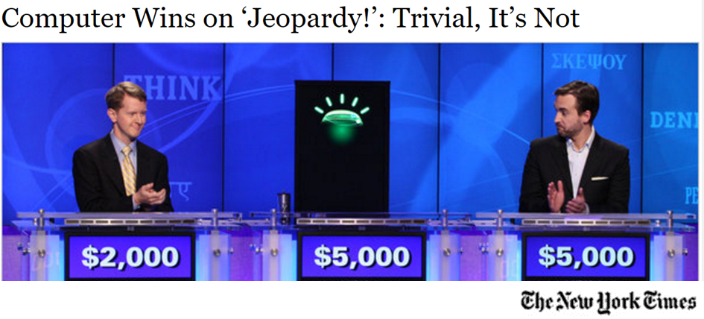
Example: Games

Slide 7
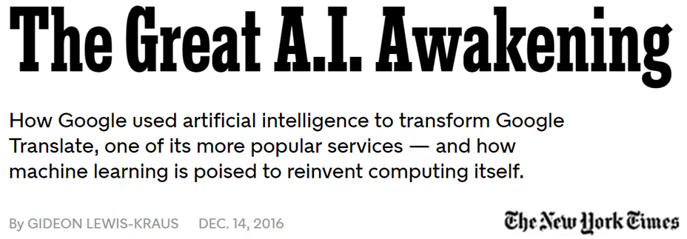
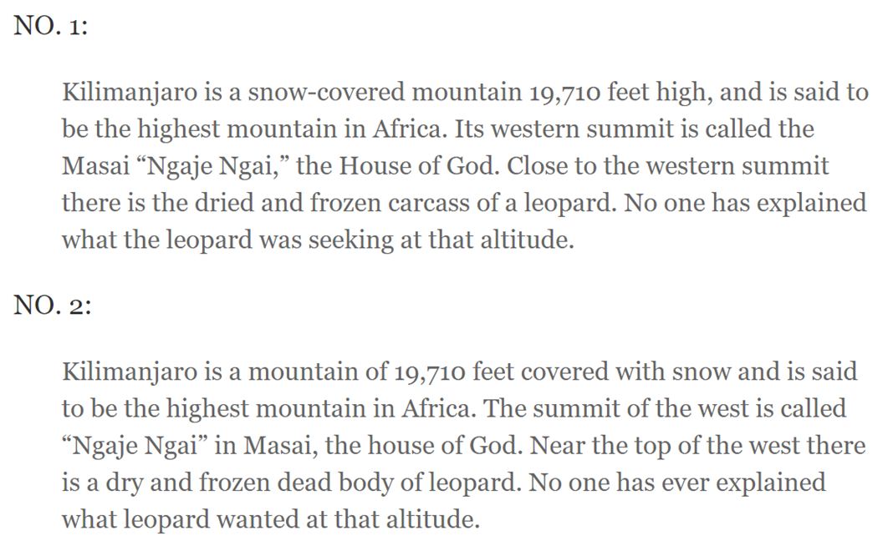
Example: Language Translation
7

Slide 8
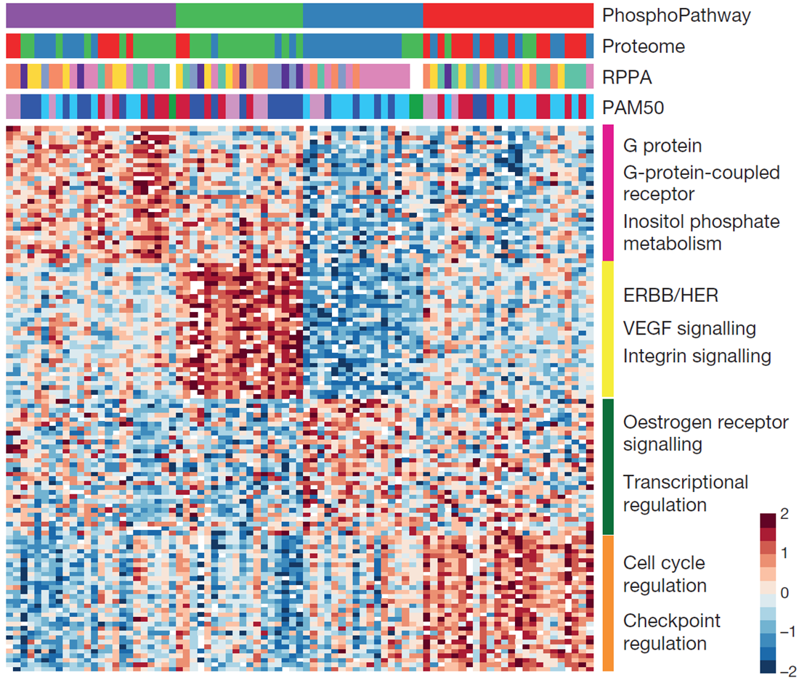
Example: Tumor Subtypes
8

Slide 9
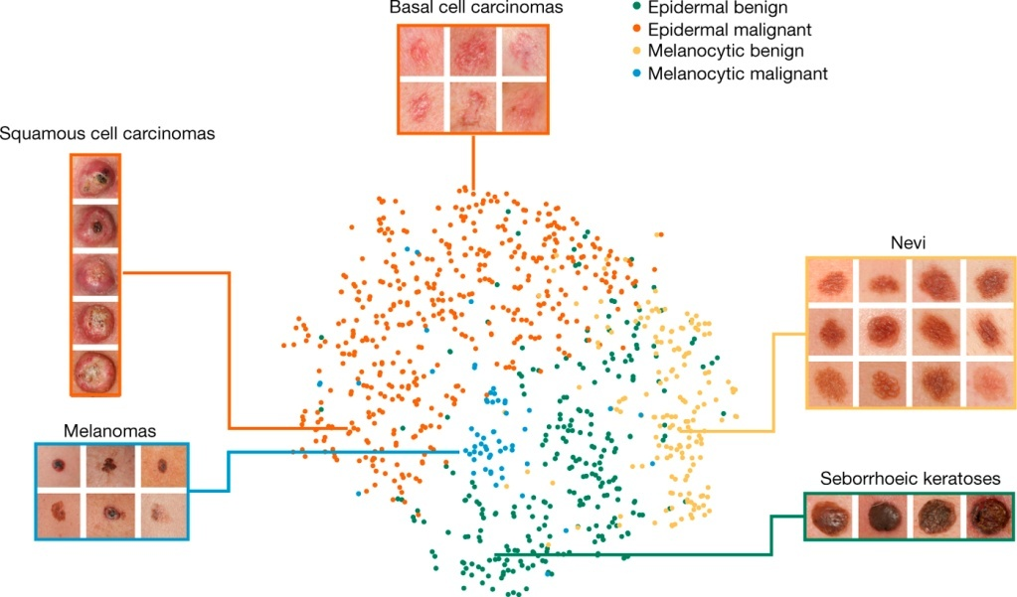
Example: Skin Cancer Diagnosis
9
Esteva et al., “Dermatologist-level classification of skin cancer with
deep neural networks”, Nature. 2017

Slide 10
Course Overview
September 6, 2018 Lecture 1 Course Overview (Fenyo & Yeaton)
September 10, 2018 Lecture 2 Unsupervised Learning: Clustering (Liu)
September 13, 2018 Lecture 3 Unsupervised Learning: Dimension Reduction (Liu & Yeaton)
September 17, 2018 Lecture 4 Student Project Plan Presentation
September 20, 2018 Lecture 5 Supervised Learning: Regression (McKerrow)
September 24, 2018 Lecture 6 Supervised Learning: Classification (Kannan)
October 1, 2018 Lecture 7 Supervised Learning: Performance Estimation & Regularization (Kannan & Yeaton)
October 4, 2018 Lecture 8 Tree-Based Methods (Kannan)
October 8, 2018 Lecture 9 Support Vector Machines (Kannan & Yeaton)
October 11, 2018 Lecture 10 Student Project Exploratory Data Analysis Presentation
October 22 Lecture 11 Neural Networks (Fenyo & Yeaton)
October 25, 2018 Lecture 12 Markov Models (Kannan & Yeaton)
October 29, 2018 Lecture 13 Feature selection (Kasthuri Kannan & Yeaton)
November 1, 2018 Lecture 14 Machine Learning Applied to Healthcare (Razavian)
November 8, 2018 Lecture 15 Machine Learning Applied to Omics Data (Ruggles)
November 12, 2018 Lecture 16 Machine Learning Applied to Text Data (Aphinyanaphongs)
November 26, 2018 Lecture 17 Student Project Presentation
November 29, 2018 Lecture 18 Student Project Presentation
10
http://fenyolab.org/ml2018fall

Slide 11
Course Overview
September 6, 2018 Lecture 1 Course Overview (Fenyo & Yeaton)
September 10, 2018 Lecture 2 Unsupervised Learning: Clustering (Liu)
September 13, 2018 Lecture 3 Unsupervised Learning: Dimension Reduction (Liu & Yeaton)
September 17, 2018 Lecture 4 Student Project Plan Presentation
September 20, 2018 Lecture 5 Supervised Learning: Regression (McKerrow)
September 24, 2018 Lecture 6 Supervised Learning: Classification (Kannan)
October 1, 2018 Lecture 7 Supervised Learning: Performance Estimation & Regularization (Kannan & Yeaton)
October 4, 2018 Lecture 8 Tree-Based Methods (Kannan)
October 8, 2018 Lecture 9 Support Vector Machines (Kannan & Yeaton)
October 11, 2018 Lecture 10 Student Project Exploratory Data Analysis Presentation
October 22 Lecture 11 Neural Networks (Fenyo & Yeaton)
October 25, 2018 Lecture 12 Markov Models (Kannan & Yeaton)
October 29, 2018 Lecture 13 Feature selection (Kasthuri Kannan & Yeaton)
November 1, 2018 Lecture 14 Machine Learning Applied to Healthcare (Razavian)
November 8, 2018 Lecture 15 Machine Learning Applied to Omics Data (Ruggles)
November 12, 2018 Lecture 16 Machine Learning Applied to Text Data (Aphinyanaphongs)
November 26, 2018 Lecture 17 Student Project Presentation
November 29, 2018 Lecture 18 Student Project Presentation
11
http://fenyolab.org/ml2018fall

Slide 12
Class Project
Pick one of the DREAM Challenges or biomedicine related Kaggle challenge for your class project and analyze the data using several different methods.
9/7 Project Plan Presentation
10/11 Project Exploratory Data Analysis Presentation
11/26 Project Presentation
11/29 Project Presentation

Slide 13
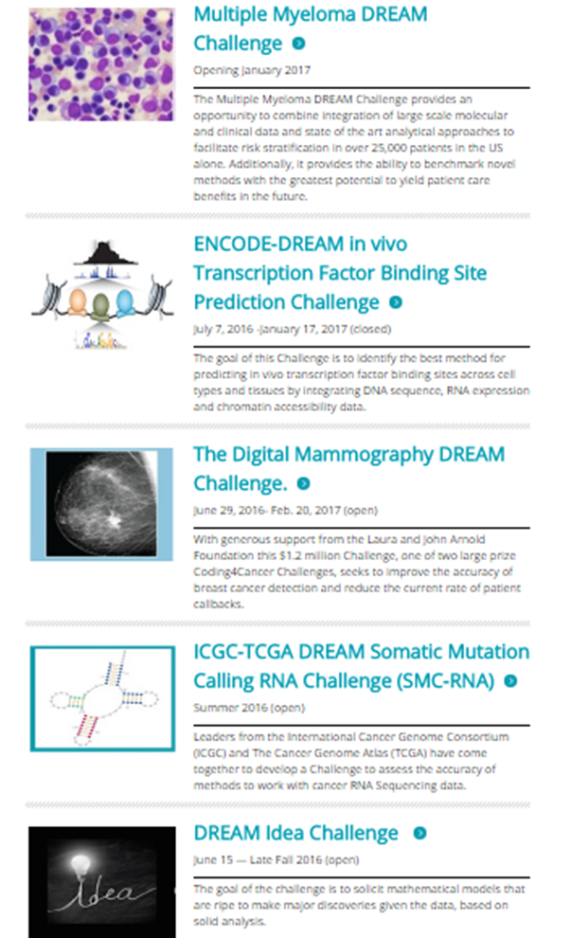

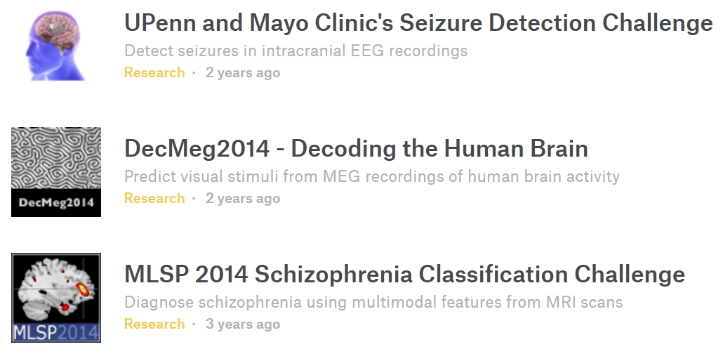
Class Presentations
Pick one ongoing DREAM or biomedicine related Kaggle challenge to preset during one of the next classes.
Kaggle

Slide 14
Crowdsourcing
Crowdsourcing is a methodology that uses the voluntary help of large communities to solve problems posed by an organization
Coined in 2006, but not new: in 1714 British Board of Longitude Prize: who can determine a ship’s longitude at sea? (winner: John Harrison, unknown clock-maker)
Different types of crowdsourcing:
  Citizen science: the crowd provides data (e.g., patients)
  Labor-focused crowdsourcing: online workforce, tasks for money
  Gamification: encode problem as game
  Collaborative competitions (challenges)
Julio Saez-Rodriguez: RWTH-Aachen&EMBL EBI

Slide 15


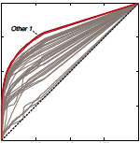

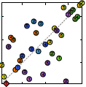
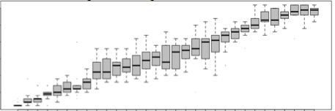
Collaborative competitions (challenges)
Post a question to whole scientific community, withhold the answer (‘gold standard’)
Evaluate submissions against the gold-standard with appropriate scoring
Analyze results
Design
Open Challenge
Scoring
Pose
Challenge
to the
Community
Challenge
Train
Test
Julio Saez-Rodriguez: RWTH-Aachen&EMBL EBI

Slide 16
Examples of DREAM challenges
  Predict phosphoproteomic data and infer signalling network - upon perturbation with ligands and drugs (Prill et al Science Signaling. 2011; Hill et al, Nature Meth 2016)
  Predict Transcription Factor Binding Sites - (with ENCODE; ongoing)
  Molecular Classification of Acute Myeloid Leukaemia - from patient samples using flow cytometry data - with FlowCAP (Aghaeepour et al Nat Meth 2013)
  Predict progression of Amyotrophic lateral sclerosis patients - from clinical trial data (Kuffner et al Nature Biotech 2015)
  NCI-DREAM Drug Sensitivity Prediction- predict response of breast cancer cell lines to single (Costello et al Nat Biot 2014) and combined (Bansal et al Nat Biot 2014) drugs
  The AstraZeneca-Sanger DREAM synergy prediction challenge - predict drug combinations on cancer cell lines from molecular data (just finished)
  The NIEHS-NCATS-UNC DREAM Toxicogenetics -
  predict toxicity of chemical compounds (Eduati et al., Nat Biot, 2015)
www.dreamchallenges.org

Slide 17
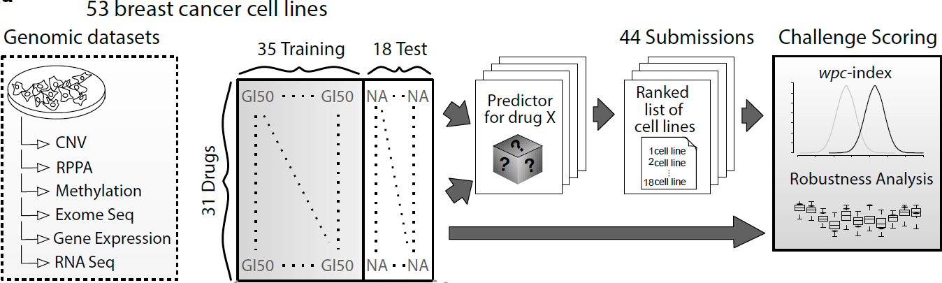
NCI-DREAM Drug sensitivity challenge
Costello et al. Nat Biotech. 2015

Slide 18
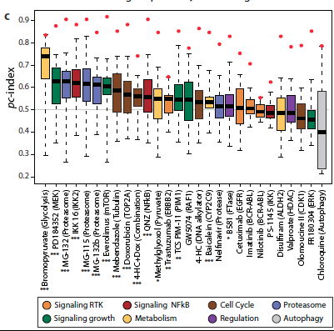
Some lessons from the drug sensitivity challenge
Some drugs are easier to predict than others, & does not depend on mode of action
Gene Expression is the most predictive data type
Integration of multiple data and pathway information layers improves predictivity
Costello et al. Nat Biotech. 2015

Slide 19
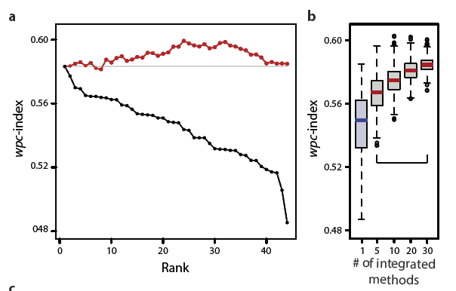
Some lessons from the drug sensitivity challenge
0.60
RANDOM
Gene expression & protein amount - the most predictive data type
Integration of multiple data and pathway information improves predictivity
There is plenty of room for improvement
The wisdom of the crowds: Aggregate is robust
Costello et al. Nat Biotech. 2015

Slide 20
Value of collaborative competitions (challenges)
  Challenge-based evaluation of methods is unbiased & enhances reproducibility
    Discover the Best Methods
    Determine the solvability of a scientific question
  Sampling of the space of methods
    Understand the diversity of methodologies used to solve a problem
  Acceleration of Research
    The community of participants can do in 4 months what would take 10 years to any group
  Community Building
    Make high quality, well-annotated data accessible.
    Foster community collaborations on fundamental research questions.
    Determine robust solutions through community consensus: “The Wisdom of Crowds.”
Julio Saez-Rodriguez: RWTH-Aachen&EMBL EBI

Slide 21
Probability: Conditional Probability
21
P(A|B) = P(A ∩ B) / P(B)
P(A)
P(B)
Ω
P(A ∩ B)

Slide 22
Probability: Bayes Rule
Multiplication Rule
22
P(A ∩ B) = P(A|B)P(B) = P(B|A)P(A)
P(A|B) = P(B|A)P(A)/P(B)
Bayes Rule
Likelyhood
P(H|D) = P(D|H) P(H) / P(D)
Hypothesis (H)
Data (D)
Posterior
Probability
Prior
Probability

Slide 23
Bayes Rule: How to Choose the Prior Probability?
Bayes Rule
P(H|D) = P(D|H) P(H) / P(D)
Hypothesis (H)
Data (D)
Posterior
Probability
Prior
Probability
If we have no knowledge, we can assume that each outcome is equally probably.
Two mutually exclusive hyposthesis H₁ and H₂:
If we have no knowledge: P(H₁) = P(H₂) = 0.5
If we find out that hypothesis H₂ is true: P(H₁) = 0 and P(H₂) = 1

Slide 24
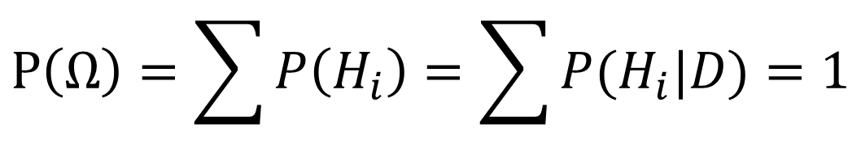
Bayes Rule: Normalization Factor
Bayes Rule
P(H|D) = P(D|H) P(H) / P(D)
Hypothesis (H)
Data (D)
Normalization
Factor
$$P\left(Ω\right)=\sum{P\left(H_{i}\right)=\sum{P(H_{i}|D)}}=1$$

Slide 25
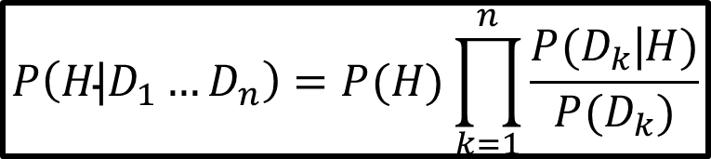
Bayes Rule: More Data
Bayes Rule
P(H|D) = P(D|H) P(H) / P(D)
Hypothesis (H)
Data (D)
Posterior
Probability
Prior
Probability
P(H|D₁) = P(D₁|H) P(H) / P(D₁)
P(H|D₁,D₂) = P(D₂|H) P(H|D₁) / P(D₂)
P(H|D₁,D₂,D₃) = P(D₃|H) P(H|D_{1,}D₂) / P(D₃)
…
$$P\left(H\text{|}D_{1}…D_{n}\right)=P(H)\prod_{k=1}^{n}{\frac{{P(D}_{k}\text{|}H)}{P(D_{k})}}$$

Slide 26
Bayes Rule: More Data
Bayes Rule
P(H|D) = P(D|H) P(H) / P(D)
Hypothesis (H)
Data (D)
Posterior
Probability
Prior
Probability
Two mutually exclusive hypothesis H₁ and H₂ (Priors: P(H₁) = P(H₂) = 0.5):
P(H₂|D₁) = P(D₁|H₂) P(H₂) / P(D₁) = 0.7
(P(H₂) = 0.5, P(D₁|H₂) / P(D₁)=1.4)
P(H₂|D₁,D₂) = P(D₂|H₂) P(H₂|D₁) / P(D₂) = 0.88
(P(H₂|D₁) = 0.7, P(D₂|H₂) / P(D₂)=1.26)
P(H₂|D₁,D₂,D₃) = P(D₃|H₂) P(H₂|D_{1,}D₂) / P(D₃) = 1
(P(H₂|D₁,D₂) = 0.5, P(D₃|H₂) / P(D₃)=1.14)

Slide 27
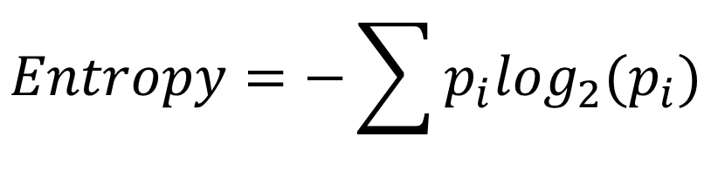
Bayes Rule and Information Theory
$$Entropy=−\sum{p_{i}\log_{2}(p_{i})}$$
Two mutually exclusive hypothesis H₁ and H₂:
If we have no knowledge: P(H₁) = P(H₂) = 0.5: Entropy=1
If hypothesis H₂ is true: P(H₁) = 0 and P(H₂) = 1 : Entropy=0
P(H₁) = 0.3, P(H₂) = 0.7: Entropy=0.88
P(H₁) = 0.11, P(H₂) = 0.89: Entropy=0.50

Slide 28
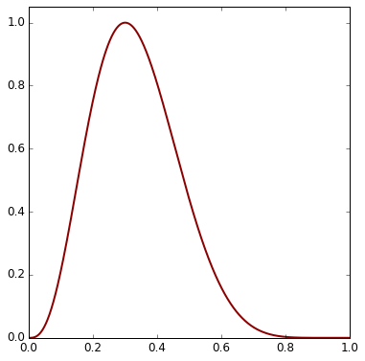
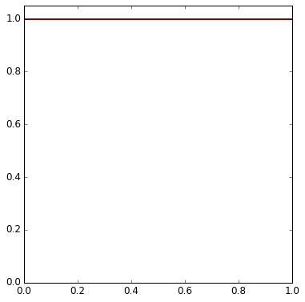
Bayes Rule: Example: What is the bias of a coin?
Bayes Rule
P(H|D) = P(D|H) P(H) / P(D)
Hypothesis (H)
Data (D)
Hypothesis: the probability for head is θ (=0.5 for unbiased coin)
Data: 10 flips of a coin: 3 heads and 7 tails.
P(D|θ) = θ³(1- θ)⁷
Uninformative prior: P(θ) uniform
Posterior Likelihood Prior

Slide 29
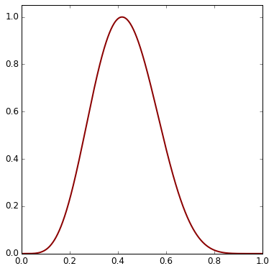
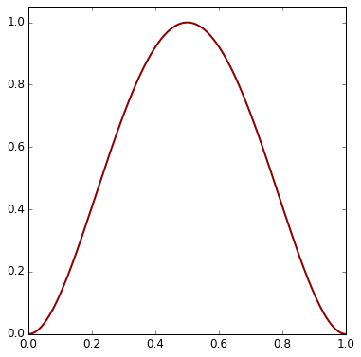
Bayes Rule: Example: What is the bias of a coin?
Bayes Rule
P(H|D) = P(D|H) P(H) / P(D)
Hypothesis (H)
Data (D)
Hypothesis: the probability for head is θ (=0.5 for unbiased coin)
Data: 10 flips of a coin: 3 heads and 7 tails.
Likelihood: P(D|θ) = θ³(1- θ)⁷
Prior: θ²(1- θ)²
Posterior Likelihood Prior
θ
θ
θ

Slide 30
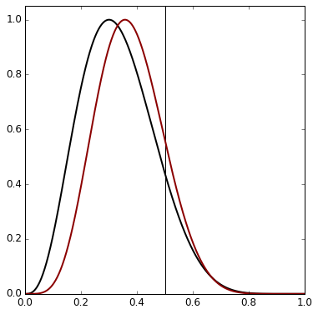
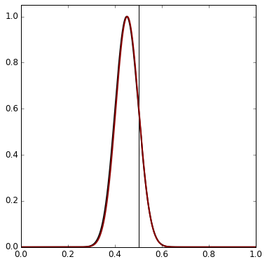
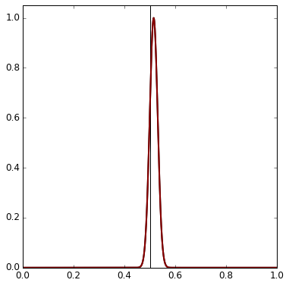
Bayes Rule: Example: What is the bias of a coin?
Posterior Probability
Data:
10 flips of a coin: 3 heads and 7 tails.
100 flips of a coin: 45 heads and 55 tails.
1000 flips of a coin: 515 heads and 485 tails.
Prior:
θ²(1- θ)²
Uniform
prior
θ

Slide 31
Unsupervised Learning
31
Finding the structure in data.
Clustering
Dimension reduction

Slide 32
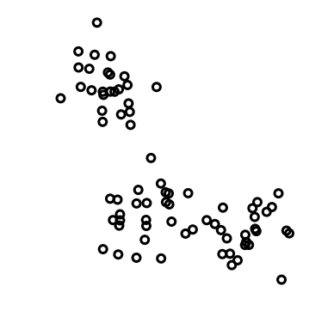
Unsupervised Learning: Clustering
32
How many clusters?
Where to set the borders between clusters?
Need to select a distance measure.
Examples of methods:
  k-means clustering
  Hierarchical clustering

Slide 33
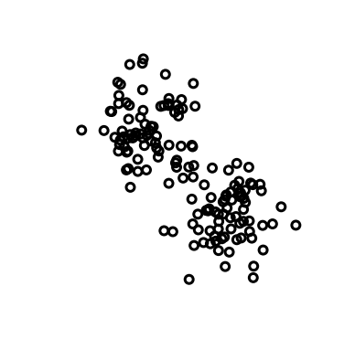
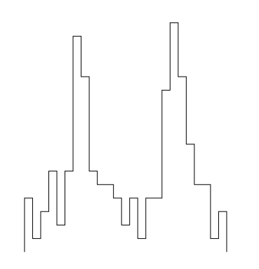
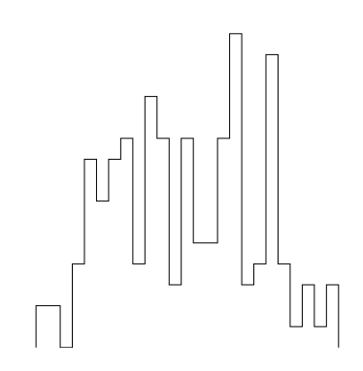
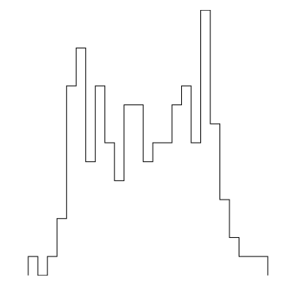
Unsupervised Learning: Dimension Reduction
Examples of methods:
  Principal Component Analysis (PCA)
  t-Distributed Stochastic Neighbor Embedding (t-SNE)
  Independent Component Analysis (ICA)
  Non-Negative Matrix Factorization (NMF)
  Multi-Dimensional Scaling (MDS)

Slide 34
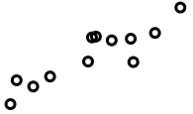
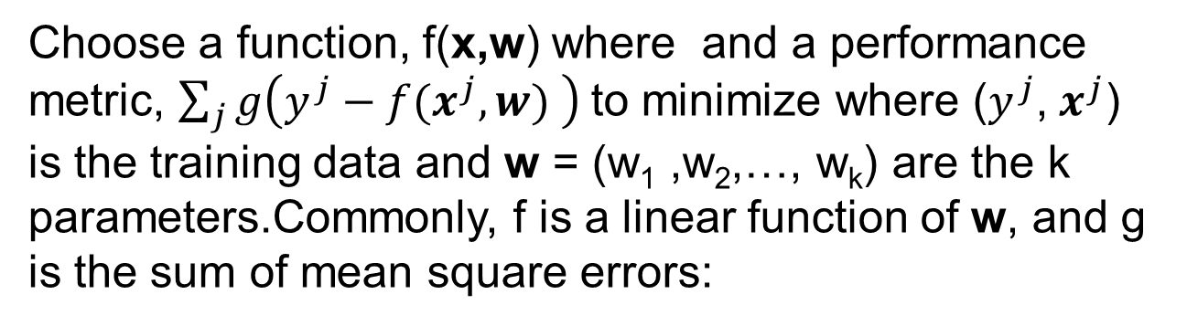
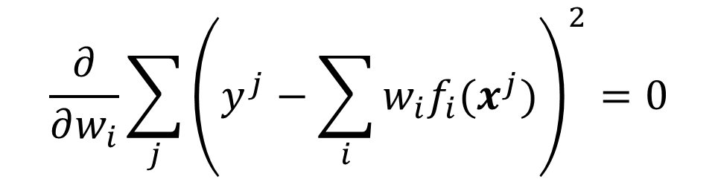
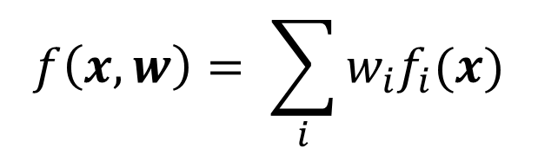
Supervised Learning: Regression
34
Choose a function, f(x,w) where and a performance metric, $\sum_{j}{g\left(y^{j}−f(x^{j},w) \right)}$to minimize where ($y^{j}$, $x^{j}$) is the training data and w = (w₁ ,w₂,…, w_{k}) are the k parameters.Commonly, f is a linear function of w, and g is the sum of mean square errors:
$$\frac{∂}{∂w_{i}}\sum_{j}{{\left(y^{j}−\sum_{i}{w_{i}f_{i}(x^{j})}\right)}^{2}}=0$$
$$f\left(x,w\right)= \sum_{i}{w_{i}f_{i}(x)}$$

Slide 35
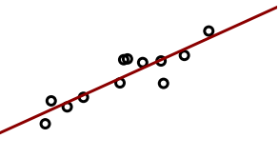
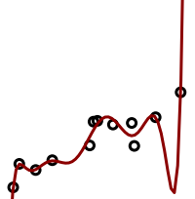
Model Capacity: Overfitting and Underfitting
35

Slide 36
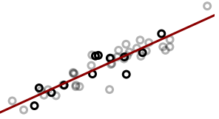
Model Capacity: Overfitting and Underfitting
36

Slide 37

Model Capacity: Overfitting and Underfitting
37

Slide 38
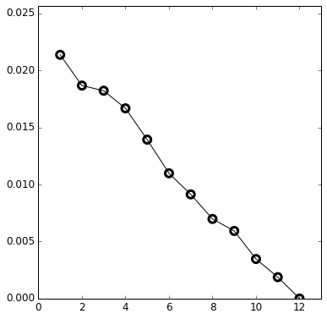
Model Capacity: Overfitting and Underfitting
38
Training Error
Error on Training Set
Degree of polynomial

Slide 39
Model Capacity: Overfitting and Underfitting
39
With four parameters I can fit an elephant, and with five I can make him wiggle his trunk.
John von Neumann

Slide 40
Training and Testing
Data
Set
Test
Training

Slide 41
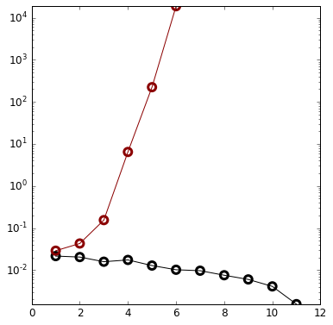
Training and Testing
Testing Error
Error on Training Set
Training Error
Degree of polynomial

Slide 42
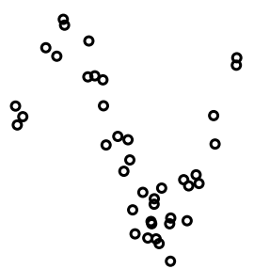
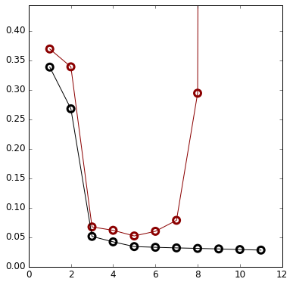
Training and Testing
Testing
Error
Error on Training Set
Training
Error
Degree of polynomial

Slide 43
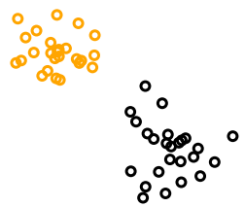
Supervised Learning: Classification
43

Slide 44
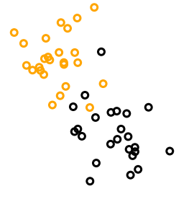
Supervised Learning: Classification
44

Slide 45
Generative or Discriminant Algorithms
Generative algorithm: Learns the probabilities of data given the hypothesis p(D|H) and the prior probability of the hypothesis p(H) and calculates the probability of the hypothesis given the data p(H|D) using Bayes Rule, and derives decision boundary using p(H|D).
- In general a lot of data is needed to estimate the conditional probabilities.
Discriminant algorithm: Learns the probability of the hypothesis given the data p(H|D) or the decision boundary directly.

Slide 46
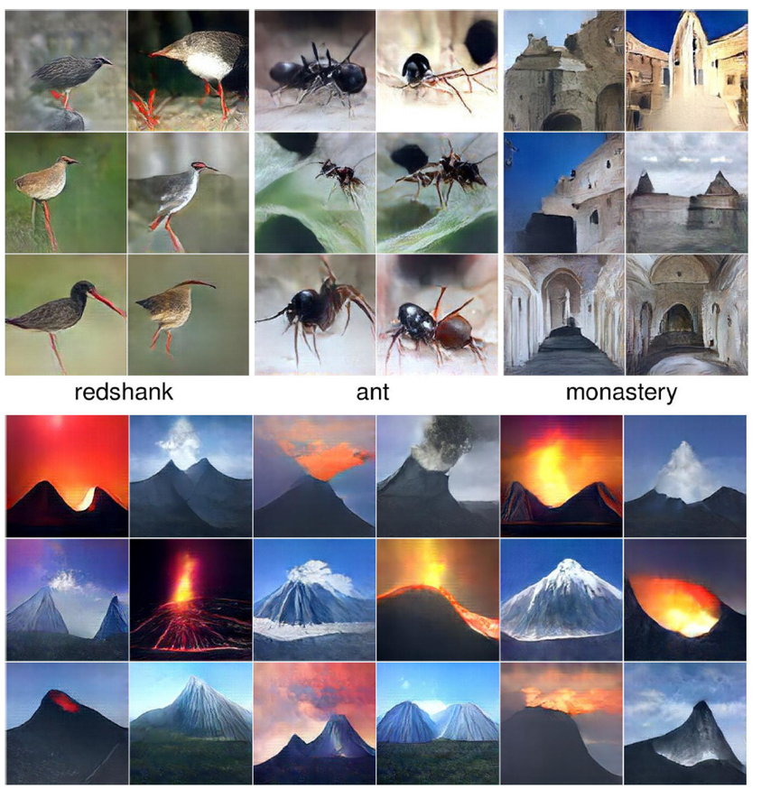
Generative or Discriminant Algorithms
“One should solve the classification problem directly and never solve a more general problem as an intermediate step“,
Vapnik, Statistical Learning Theory, John Wiley & Sons 1998
Nguyen et al., “Plug & Play Generative Networks: Conditional Iterative Generation of Images in Latent Space”, https://arxiv.org/abs/1612.00005.

Slide 47
Evaluation of Binary Classification Models
Predicted
0 1
True
Negative
False
Positive
0
1
47
Actual
False
Negative
True
Positive
False Positive Rate = FP/(FP+TN) – fraction of label 0 predicted to be label 1
Accuracy = (TP+TN)/total - fraction of correct prediction
Precision = TP/(TP+FP) – fraction of correct among positive predictions
Sensitivity = TP/(TP+FN) – fraction of correct predictions among label 1. Also called true positive rate and recall.
Specificity = TN/(TN+FP) – fraction of correct predictions among label 0

Slide 48
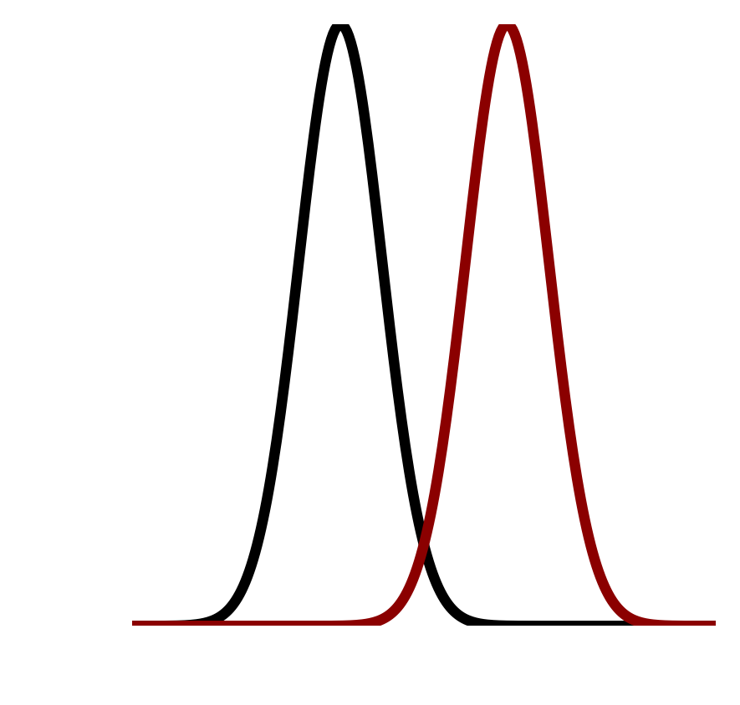
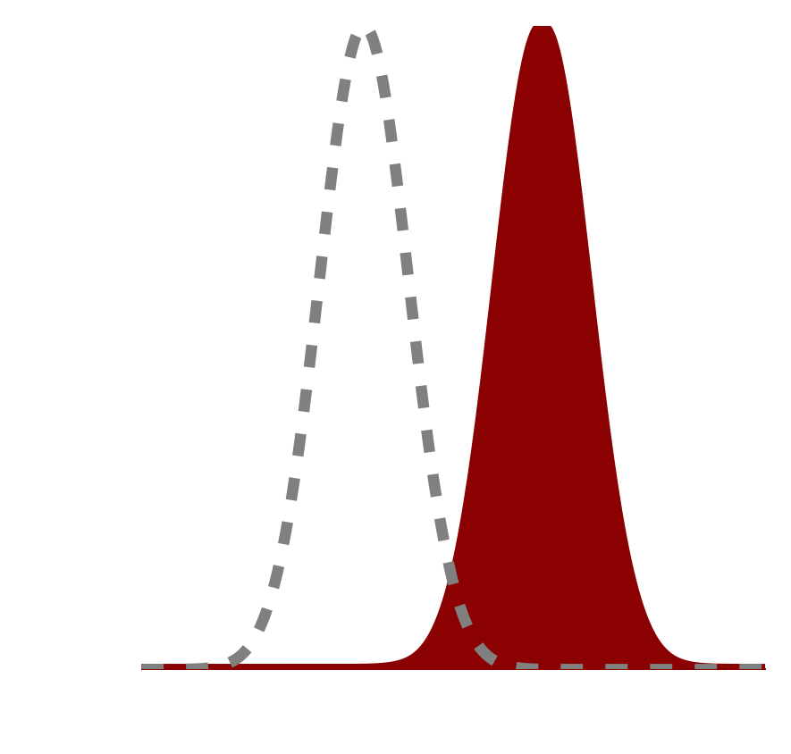











Evaluation of Binary Classification Models
Label 0
Label 1
Label 0
Label 1
True
Positives
True
Positives
False
Positives
False
Positives

Slide 49




Evaluation of Binary Classification Models
Label 0
Label 0
Label 1
Label 1
False
Positives
False
Positives
True
Positives
True
Positives

Slide 50






Evaluation of Binary Classification Models
False
Positive
Rate
False
Positive
Rate
False
Positive
Rate
False
Positive
Rate
True
Positive
Rate
True
Positive
Rate
True
Positive
Rate
True
Positive
Rate
Receiver Operator Characteristic (ROC)
True Positive Rate
True Positive Rate
True Positive Rate
True Positive Rate
False Positive Rate
False Positive Rate
False Positive Rate
False Positive Rate

Slide 51
Training: Gradient Descent
51

Slide 52
Training: Gradient Descent
52

Slide 53
Training: Gradient Descent
53

Slide 54
Training: Gradient Descent
54

Slide 55
Training: Gradient Descent
55
We want to use a large training rate when we are far from the minimum and decrease it as we get closer.

Slide 56
Training: Gradient Descent
56
If the gradient is small in an extended region, gradient descent becomes very slow.

Slide 57
Training: Gradient Descent
57
Gradient descent can get stuck in local minima.
To improve the behavior for shallow local minima, we can modify gradient descent to take the average of the gradient for the last few steps (similar to momentum and friction).

Slide 58




Linear Regression – Error Landscape
Sum of Square Errors
Slope

Slide 59

Linear Regression – Error Landscape
Slope
Sum of Square Errors
Intercept
Slope

Slide 60

Linear Regression – Error Landscape
Slope
Sum of Square Errors
Intercept
Slope

Slide 61




Linear Regression – Error Landscape
Sum of Square Errors

Slide 62


Linear Regression – Error Landscape
Sum of Square Errors

Slide 63


Linear Regression – Error Landscape
Sum of Absolute Errors

Slide 64






Linear Regression – Error Landscape

Slide 65

Gradient Descent

Slide 66


Gradient Descent

Slide 67


Gradient Descent

Slide 68


Gradient Descent

Slide 69


Linear Regression – Gradient Descent

Slide 70


Linear Regression – Gradient Descent

Slide 71


Linear Regression – Gradient Descent

Slide 72


Linear Regression – Gradient Descent

Slide 73


Gradient Descent

Slide 74
Gradient Descent
Batch gradient descent: Uses the whole training set to calculate the gradient for each step.
Stochastic gradient descent or Mini-batch gradient descent: Uses a subset of the training set to calculate the gradient for each step.

Slide 75


Gradient Descent – Learning Rate
Too Small
Too Large

Slide 76

Gradient Descent – Learning Rate Decay
Constant
Learning Rate
Decaying
Learning Rate

Slide 77



Gradient Descent – Unequal Gradients
Constant
Learning Rate
Decaying
Learning Rate
Partially Remembering
Previous Gradients

Slide 78

Gradient Descent
Sum of
Square Errors
Sum of
Absolute Errors

Slide 79




Outliers
Sum of
Square Errors
Sum of
Absolute Errors

Slide 80


Variable Variance

Slide 81





Logistic Regression
Linear Regression:
$$y=w_{1}x_{1}+w_{0}+ε$$
Logistic Regression:
$$y=σ(w_{1}x_{1}+w_{0}+ε)$$
where $σ(t)=\frac{1}{1+e^{−t}}$
81
$$w_{1}=1$$
$$w_{1}=10$$

Slide 82







Logistic Regression
$$w_{1}=1$$
$$w_{1}=10$$
$y=σ(x∙w+ε)$
where $σ(t)=\frac{1}{1+e^{−t}}$
$$\frac{dσ(t)}{dt}=σ(t)(1−σ(t))$$
$$w_{1}=1$$
$$w_{1}=10$$

Slide 83

Logistic Regression
83

Slide 84







Logistic Regression – Error Landscape
$$w_{1}$$
$$w_{0}$$
$$w_{0}$$
$$w_{1}$$

Slide 85








Logistic Regression – Error Landscape
$$w_{1}$$
$$w_{1}$$
$$w_{0}$$
$$w_{0}$$

Slide 86












Logistic Regression – Error Landscape
$$w_{1}$$
$$w_{1}$$
$$w_{1}$$
$$w_{0}$$
$$w_{0}$$
$$w_{0}$$

Slide 87






Logistic Regression – Gradient Descent
$$w_{1}$$
$$w_{1}$$
$$w_{0}$$
$$w_{0}$$
  Hyperparameters:
  Learning rate
  Learning rate schedule
  Gradient memory

Slide 88









Logistic Regression – Regularization
No regularization
Regularization
$$w_{1}$$
$$w_{1}$$
$$w_{0}$$
$$w_{0}$$
$$w_{0}$$
$$w_{1}$$
$$w_{1}$$

Slide 89
Curse of Dimensionality
89
When the number of dimensions increase, the volume increases and the data becomes sparse.
It is typical for biomedical data that there are few samples and many measurements.

Slide 90
Validation: Choosing Hyperparameters
Data
Set
Test
Training

Slide 91
Validation: Choosing Hyperparameters
Data
Set
Test
Validation
Training
Examples of hyperparameters:
  Learning rate
  Regularization parameter

Slide 92
Cross-Validation
92
Data
Set
Test
Training
Training 1
Validation 1
Training 2
Validation 2
Training 3
Validation 3
Training 4
Validation4

Slide 93
Preparing Data
93
Cleaning the data
Handling missing data
Transforming data

Slide 94
Missing Data
94
Missing completely at random
Missing at random
Missing not at random

Slide 95
Missing Data
95
Discarding samples or measurements containing missing values
Imputing missing values

Slide 96

Sampling Bias
96

Slide 97

Sampling Bias
97
DF Ransohoff, "Bias as a threat to the validity of cancer molecular-marker research", Nat Rev Cancer 5 (2005) 142-9.

Slide 98
Data Snooping
98
Do not use the test data for any purpose during training.

Slide 99

Data Snooping
99
https://xkcd.com/882/

Slide 100

No Free Lunch
100
Wolpert, David (1996), Neural Computation, pp. 1341-1390.

Slide 101


Can we trust the predictions of classifiers?
101
Ribeiro, Singh and Guestrin ,"Why Should I Trust You? Explaining the Predictions of Any Classifier“, In: ACM SIGKDD International Conference on Knowledge Discovery and Data Mining (KDD), 2016

Slide 102

Adversarial Fooling Examples
Original correctly
classified image
Classified
as ostrich
Perturbation
102
Szegedy et al., “Intriguing properties of neural networks”, https://arxiv.org/abs/1312.6199

Slide 103
Course Overview
September 6, 2018 Lecture 1 Course Overview (Fenyo & Yeaton)
September 10, 2018 Lecture 2 Unsupervised Learning: Clustering (Liu)
September 13, 2018 Lecture 3 Unsupervised Learning: Dimension Reduction (Liu & Yeaton)
September 17, 2018 Lecture 4 Student Project Plan Presentation
September 20, 2018 Lecture 5 Supervised Learning: Regression (McKerrow)
September 24, 2018 Lecture 6 Supervised Learning: Classification (Kannan)
October 1, 2018 Lecture 7 Supervised Learning: Performance Estimation & Regularization (Kannan & Yeaton)
October 4, 2018 Lecture 8 Tree-Based Methods (Kannan)
October 8, 2018 Lecture 9 Support Vector Machines (Kannan & Yeaton)
October 11, 2018 Lecture 10 Student Project Exploratory Data Analysis Presentation
October 22 Lecture 11 Neural Networks (Fenyo & Yeaton)
October 25, 2018 Lecture 12 Markov Models (Kannan & Yeaton)
October 29, 2018 Lecture 13 Feature selection (Kasthuri Kannan & Yeaton)
November 1, 2018 Lecture 14 Machine Learning Applied to Healthcare (Razavian)
November 8, 2018 Lecture 15 Machine Learning Applied to Omics Data (Ruggles)
November 12, 2018 Lecture 16 Machine Learning Applied to Text Data (Aphinyanaphongs)
November 26, 2018 Lecture 17 Student Project Presentation
November 29, 2018 Lecture 18 Student Project Presentation
103
http://fenyolab.org/ml2018fall

